Slide 1
PYTHON WITH AI
Prepared by Sir Haroon

Slide 2
LECTURE 31
Numpy Part-II

Slide 3
INDEXING AN ARRAY IN NUMPY
As we are studying the Numpy library, now we will see how indexing, slicing and strides are applied on a numpy array.
But why are we doing this?
Because, when we want to access the specific portions of our array, we need indexing and slicing methods.
Note that we can also use negative indexing. (-1,-1) will be considered as the last row element and column element.

Slide 4
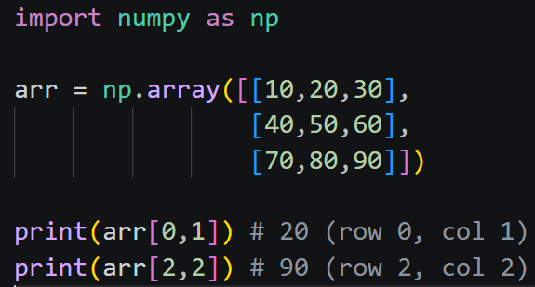
INDEXING AN ARRAY IN NUMPY

Slide 5
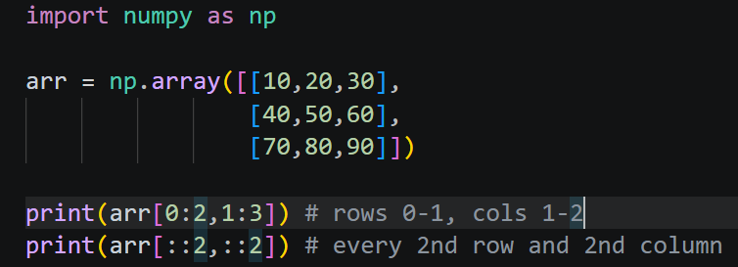
INDEXING AN ARRAY IN NUMPY

Slide 6
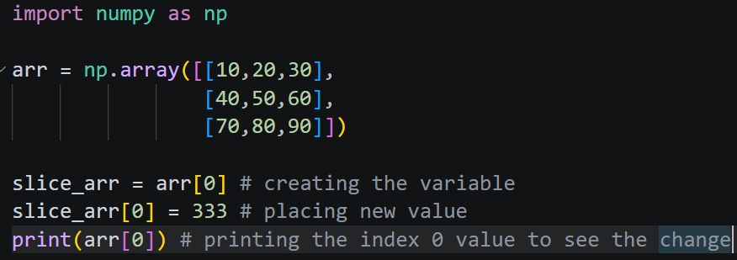
SLICING IN NUMPY ARRAY
Note that whenever we apply slicing on an array, all the slicing is applied to a the current array. No new array is created. For example,

Slide 7
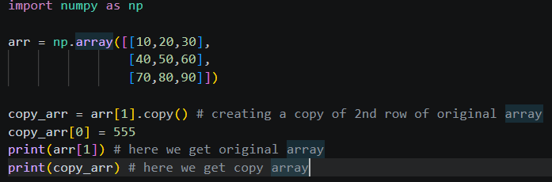
SLICING IN NUMPY ARRAY
In order to create a copy of the original array, copy() function is used. For example,

Slide 8
RANDOM NUMBER GENEARATION
We often require random numbers in matrices of large rows and columns when building AI and machine learning tools.
For that purpose, python gives the function of random number generator.
When experimenting AI & machine learning tools, we test our model repeatedly to evaluate its performance on same data. To achieve our goal, we use seed.

Slide 9
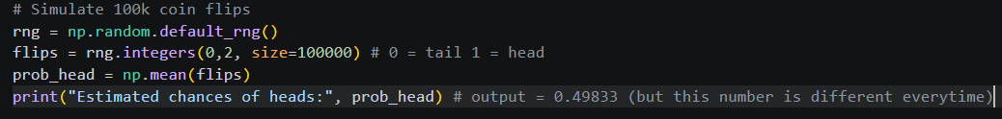
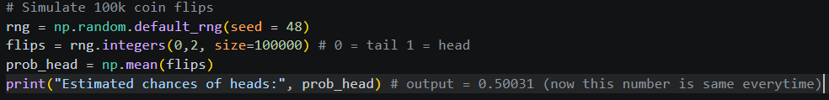
RANDOM NUMBER GENEARATION
A seed is an initial value that helps determine the sequence of random numbers.
without using seed
using seed

Slide 10
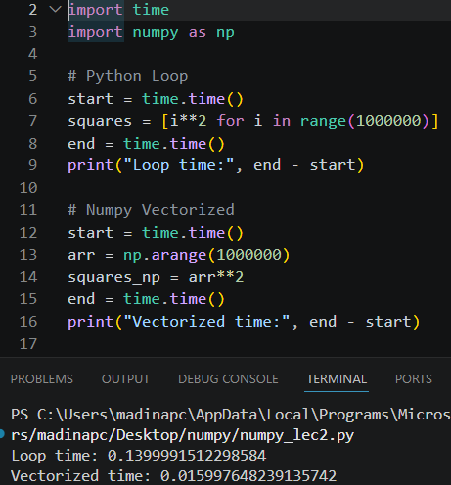
VECTORIZATION IN NUMPY

